Slide 1
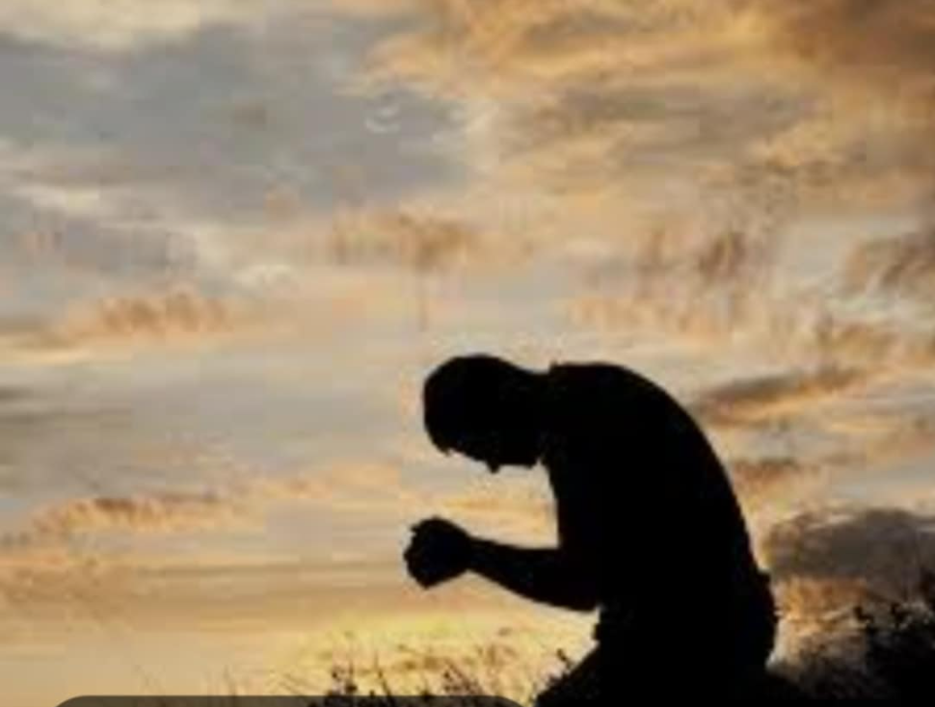
TRUE GREATNESS
Mark 10:35-45
Sis. Liezel

Slide 2
HOW TO GREAT
1. Be Humble
2. Serve Others
3. Use Power to serve and not to be serve
4. Love selflessly

Slide 3
HOW TO GREAT
5. Don't seek greatness through ambition
6. Support the Gospel Ministry
7. Carry Each Other's Burdens.

Slide 4
CONCLUSION
Jesus calls us to a life of service not to seek Glory or power.
James &John misunderstood what it means to follow Jesus .
But through the passage we see that true greatness comes from humbling ourselves and serving others. Let us grow in our discipleship by following Jesus example whom He serve first His disciple. (By washing His disciple feet)

Slide 5
TO GOD
BE ALL THE GLORY

